Slide 1
SplendorAI
Group 20
Victoria | Daniel | Yan Hong | Gabriel

Slide 2

Project Overview
In this project, we attempt to create an AI that is able to understand the goal of the game and play substantially well against humans.
For the scope of this project, we have simplified the rules to form a relaxed problem of the board game Splendor.

Slide 3
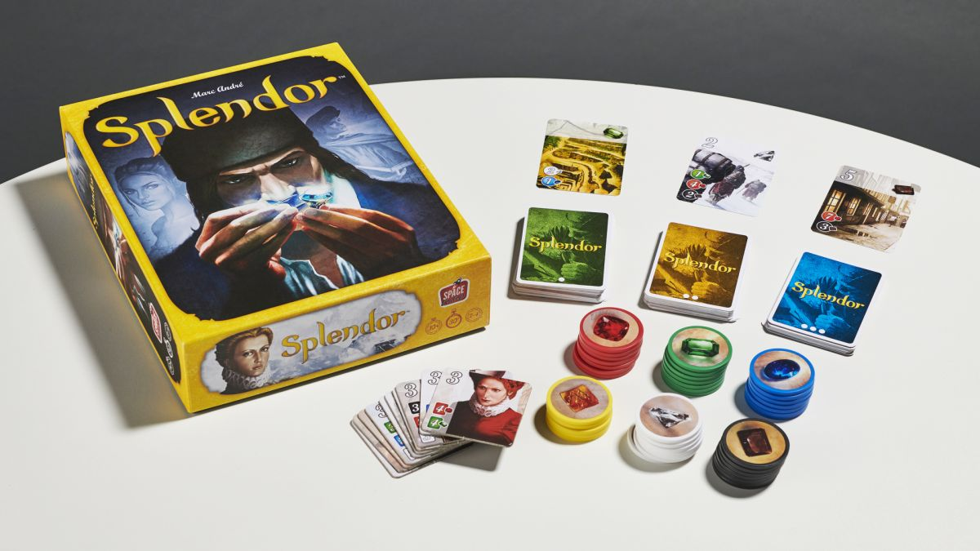
Splendor
Splendor is a board game of token-collecting and card development, which can be played with 2-4 players.
The player to first reach 15 prestige points wins. Prestige points are earned by collecting cards and earning nobles. Tokens are used to purchase cards.

Slide 4

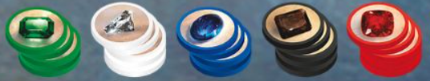
Modified Game Rules
Cards
5 different types, 3 tiers, each with a card cost. Point value from 0-5 depending on tier.
Bank
Holds 5 types of tokens, 4 units each.
Board
3 x 4 array of open cards (4 cards for each tier). Cards are replaced when bought by a player.
Notes:
https://boardgamearena.com/gamepanel?game=splendor

Slide 5

Modified Game Rules
Nobles
Player
Unique cards with point value 3
Specific card type requirement.
Automatically gains one noble at the end of their turn if eligible.
2 players only.
Use tokens to buy cards.
Can hold up to 10 tokens at a time
Keep tally of amount of each card type owned.
Notes:
https://boardgamearena.com/gamepanel?game=splendor

Slide 6
Modified Game Rules
Initial State
All Cards in deck except 4 open cards per tier
5 Different Tokens, 4 each
2 Players with 0 Points, Cards, and Tokens
2 Noble Cards
Goal
Player has 15 or more points
Opponent has less points than Player
Notes:
https://boardgamearena.com/gamepanel?game=splendor

Slide 7
Player Actions
Take Tokens
Buy Card
Players are able to purchase open cards. Once purchased, the point value of the card is added to the player’s point tally and the number of cards for that specific colour that the player owns will be updated. A card will be drawn from the respective deck to replace the one that was purchased.
The player can choose to either take 2 of the same token, provided there is at least 4 of that token type in the bank, or single tokens from 3 different types. They can also choose to take less tokens than the allowed number to avoid going over the 10 token limit.
At the end of each round, the game checks for any nobles that can be earned and finally checks if there is a winner.

Slide 8
Player Actions
Take Tokens
1 of 3 different types
2 of 1 similar type
Reserve Cards
Total
Reserve Open Card
Reserve Deck Card (Unknown)
XX Separate Player Actions
Buy Cards
Buy Any Open Card
Buy Reserved Card

Slide 9
Player Actions (Modified Rules)
Take Tokens
1 of 3 different types
5C3 = 10 Variations
2 of 1 similar type
5 Variations
Total
27 Separate Player Actions
Buy Cards
Buy Any Open Card
3 * 4 = 12 Variations

Slide 10
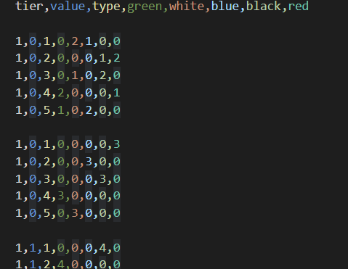
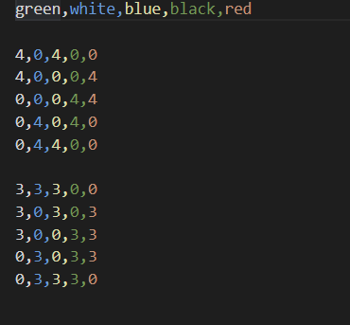
Game Data
Cards
Nobles

Slide 11
MiniMax
and interactive GUI

Slide 12
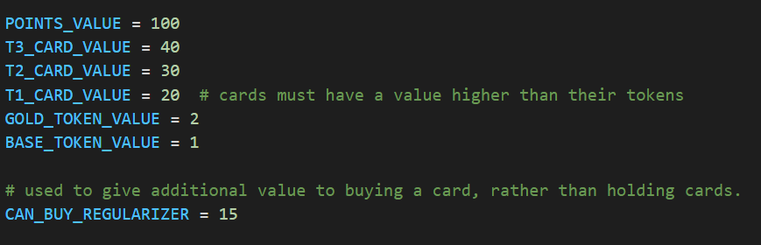
Assigning State Value with heuristics
Key challenges:
Assigning value to a combinations of tokens that can lead to buying of cards
Incentivize the AI to buy cards instead of collecting tokens
value = Tier of card value - Sum of spent tokens - regularizer
Notes:
How do we assign values to the state such that the AI knows the best move to make? Besides simply assigning value to assets the player has, we also need to assign additional value to the state if the player can buy a card in the next turn, thereby prioritizing taking certain tokens over others. This was originally implemented as the Tier of card value minus the sum of its spent tokens. However that posed another problem. The AI was then motivated instead to collect as many combinations of tokens as possible instead of buying the card. Because of this, we need a regularizer to reduce the value of token combinations.

Slide 13
Evaluation
Optimal depth of the minimax algorithm is 3 layers
Alpha-beta pruning helped to reduce the overall number of moves computed significantly.
On average, the AI takes 14.13 seconds to compute its next move.
Notes:
High branching factor (27 possible moves) limited the depth of the minimax algorithm to 3 layers. Any higher would lead to computation time of over 5 minutes which was not feasible. Alpha-beta pruning helped to reduce the overall number of moves computed significantly as well. Because of the complexity of the game, the AI will not be able to envision and compute through all possible moves from start to end. However, it is still proficient enough to make intelligent moves that could lead it to victory. Since it is able to calculate up to a depth of 3, it is smart enough to react if the player is going to buy the card before the AI does.

Slide 14
GUI Demo

Slide 15
Monte-Carlo Tree Search

Slide 16
Algorithm
Selection
Expansion
From the root node, select “promising” child nodes until a leaf node (i.e. an unexpanded node) is visited.
For each possible move from the board position represented by the node, create a new child node and edge.

Slide 17
Algorithm
Simulation
Backpropagation
From these child nodes, play a number of random games and average the results.
Update each parent node with the new “evaluation” of the children.

Slide 18
Challenges
In Python, this entire process takes a lot of time
At 1 rollout/simulation step, we only have about 70 iterations of the MCTS algorithm per second
Occasional illogical behaviour
Program passes despite having other legal moves
Program tends to hoard tokens rather than buying cards
Usually more ways to collect tokens than buy cards

Slide 19
Deep Q-Learning

Slide 20
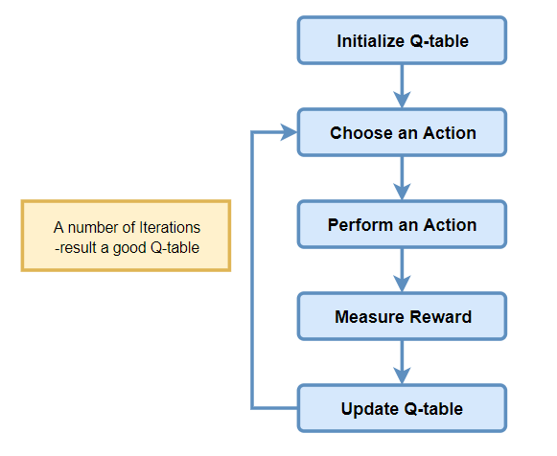
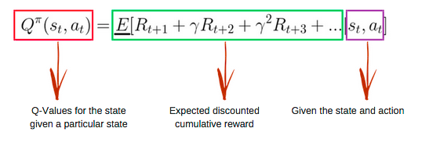
Q-Learning
Model-free, Off-policy
Q-learning finds an optimal policy, maximising the expected value of the total reward over any and all successive steps, starting from the current state
Q-table
Action-Reward ‘Cheat Sheet”
The Q-table stores the reward values for each action at every state.
The table is first initialised to zero, and its values are iteratively updated during training.
Notes:
An off-policy learner learns the value of the optimal policy independently of the agent's actions. Q-learning is an off-policy learner. An on-policy learner learns the value of the policy being carried out by the agent including the exploration steps.

Slide 21
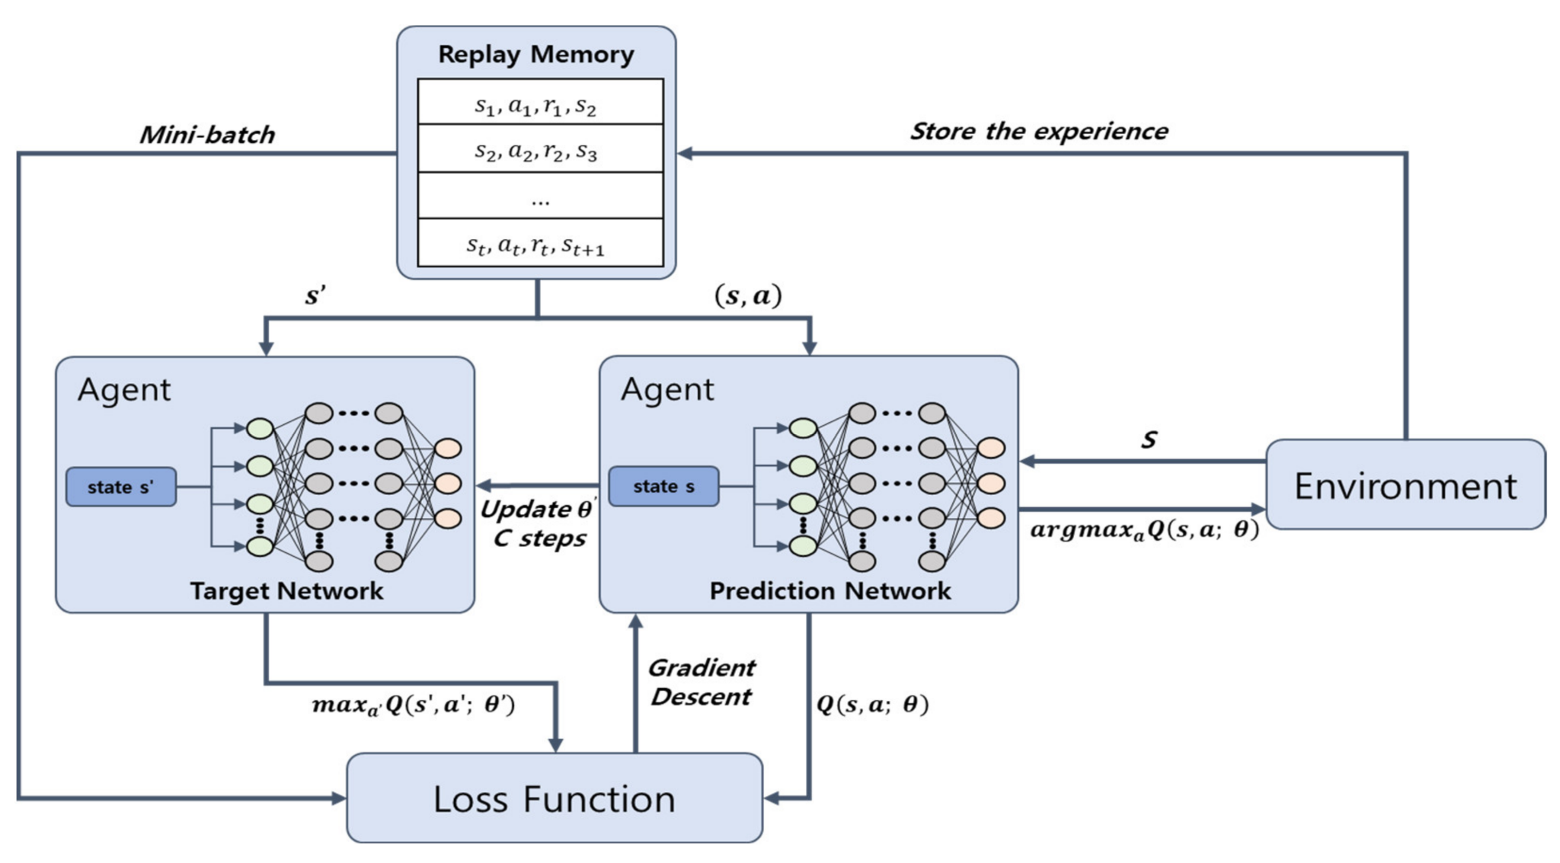
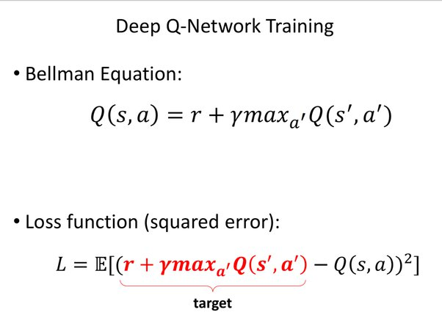
Deep Q-Learning
Replaces the Q-Table with a nonlinear function approximator, a neural network (deep q-network)
Aims to train a policy that tries to maximise the discounted, cumulative reward
Consists of 2 neural networks (Target and Prediction/Policy) for stability
Notes:
RL is unstable or divergent when a nonlinear function approximator such as a neural network is used to represent Q.
This instability comes from the correlations present in the sequence of observations, the fact that small updates to Q may significantly change the policy of the agent and the data distribution, and the correlations between Q and the target values.

Slide 22
Why Not Q-Learning?
Q
Imagine a problem with many different possible states and many permissible actions at each state
unreasonably long time to learn
Q-table would be very large and require a lot of disk space
RAM intensive: memory required to save and update that table increases with number of states and actions
For some problems, it is not easy to derive the Q-value of new states from previously explored states
DQN provides a plausible approximation, enabling the model to learn the reward values of different actions.

Slide 23
Implementation

Slide 24
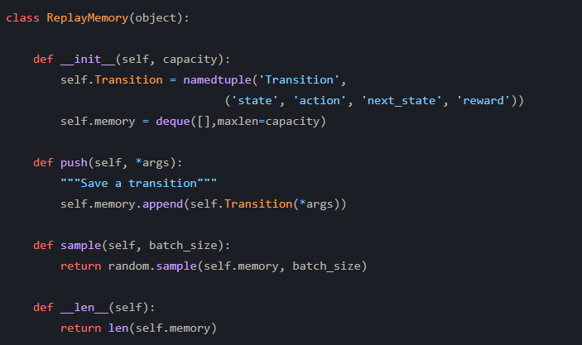
Replay Memory
Initialized to 10, 000 transition states

Slide 25
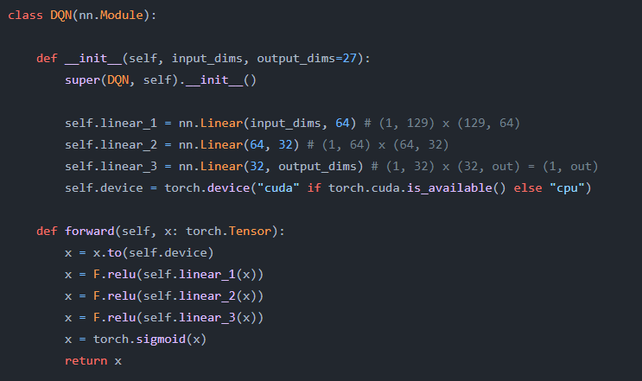
DQN Architecture
Basic feed-forward neural network
Same architecture for policy and target nets

Slide 26
DQN Inputs
DQN Outputs
Array of dimensions (1, 129) representing game state
12 open cards: 12 x (1, 7)
3 nobles: 3 x (1, 6)
player1: (1, 11)
player2: (1, 11)
bank: (1, 5)
Number between 0 - 26
Index representing a specific action the player will take

Slide 27
Reward Function
Goal: Prioritize actions that lead to increase in points
+1 if taking tokens
+card_value if buying card
+ 3 if win game
-1 if lose game

Slide 28
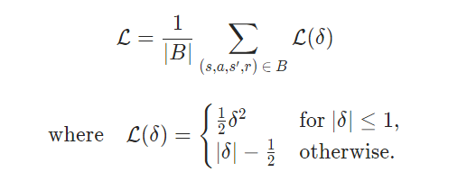
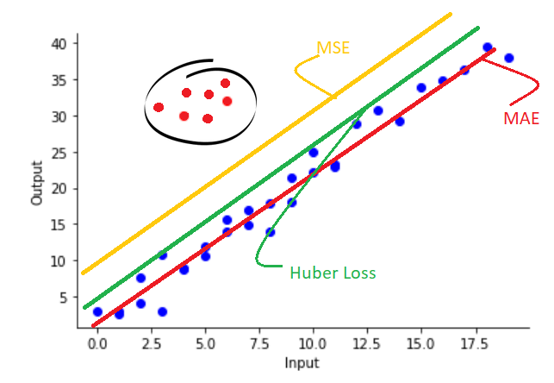
Loss Function: Huber Loss
Often used in robust regression
Less sensitive to outliers in data as compared to other squared error losses

Slide 29
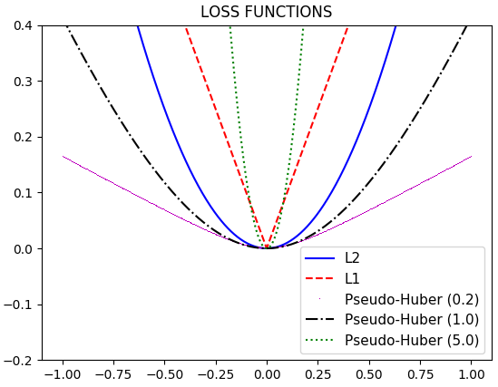
Pytorch’s Huber Loss
PyTorch’s pseudo-Huber loss:
Approximation by combining the best properties of L2 squared loss and L1 absolute loss by being strongly convex when close to the target, and less steep for extreme values.
d -> 0, converges to L1Loss
d = 0, loss is equivalent to L1 loss.
d -> +∞, loss converges to a constant 0 loss
Notes:
quadratic for small values of a, and linear for large values

Slide 30
Training
DQN is its own adversary: controls actions of both player 1 and 2
Consider player 1 as ‘itself’
Reward: 3 if player 1 wins, -1 if player 2 wins
Optimizer: Root Mean Square Propagation (RMSProp)
Stochastic batching is implemented to calculate max Q value over all sampled states
Dump all transition states into a dataloader, accumulate predictions over each transition and find take the max Q value

Slide 31
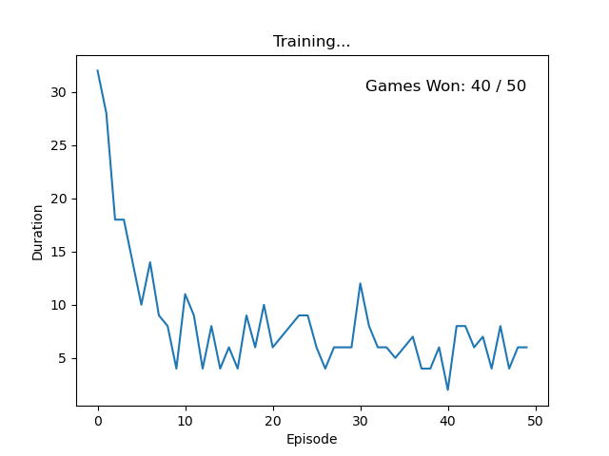
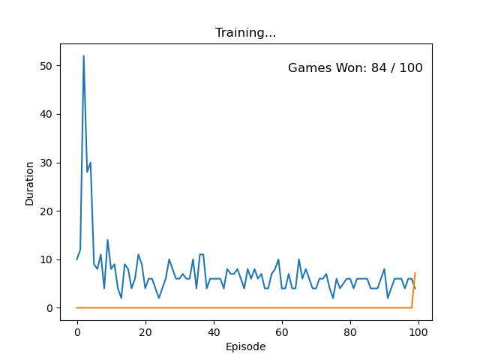
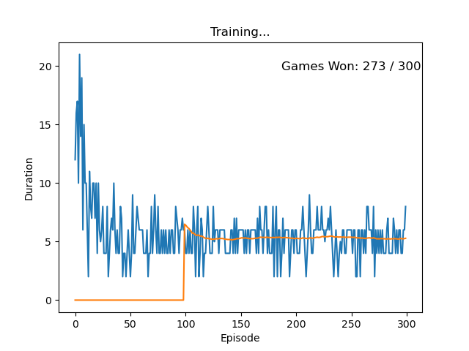
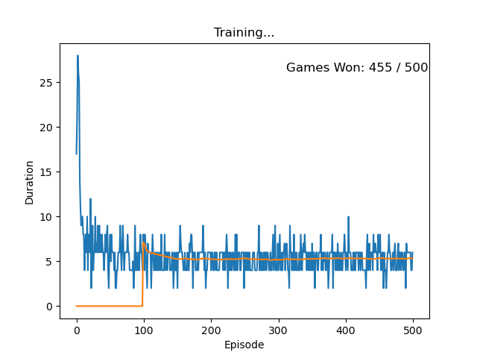
Results
# Games Played | # Games Won | % Games Won
50 | 40 | 80
100 | 84 | 84%
300 | 273 | 91%
500 | 455 | 91%
performance appears to gradually improve with an increasing number of games played, up to a maximum of 91% of games won with 300 and 500 games.

Slide 32
Conclusion

